Slide 1

Starting School at
Stoke Damerel Primary Academy

Slide 2
Welcome
Agenda:
- Short presentation and introduction of staff
- time to play, explore, and ask questions
- pick up your induction packs

Slide 3

Our school ethos and values
🌟 ‘Dream Big Achieve Together’
Our motto guides everything we do.
💡 Inspiring Ambition
Exciting opportunities that spark curiosity and potential.
🌱 Growing Life Skills
We nurture resilience, independence, creativity, and teamwork.
🏫 Part of Something Bigger
Proud to be one of 13 schools in the Reach South Academy Trust, working across the South West.

Slide 4
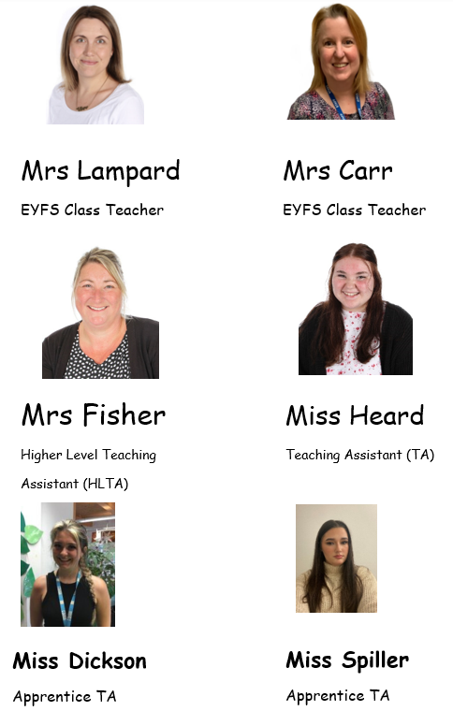
Staff

Slide 5
A typical day in Foundation
🚪 Drop-Off at the Gate
Warm welcome from teachers as children enter independently.
🎒 Getting Ready
Coats and bags on pegs, lunch chosen via the online system.
🔤 RWI Phonics
Daily Read Write Inc. session to build early reading skills.
🤸 Movement Break
Short active session to refresh minds and bodies.
📚 English Input
Exploring stories and quality texts together.
🧸 Continuous Provision & Snack
Child-led learning through play, paired with a healthy snack.
➕ Maths Time
Hands-on learning to build early number sense.
🍽️ Lunchtime
Eating together and playing outside with friends.
🌳 Afternoon Learning
Mini lesson input followed by continuous provision or Forest School adventures.
📖 Home-Time Story
A calm, shared story to end the day.
👋 Pick-Up at the Gate
Parents reunite with children at the same gate.

Slide 6
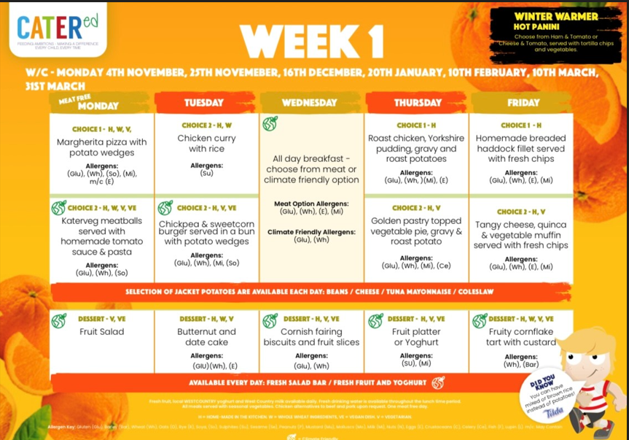
Lunchtime

Slide 7
Settling in
💛 Positive First Steps
We encourage a calm and confident start—reassure, then drop and go. This helps children settle quickly and build independence from day one.
🗓️ Staggered Start Schedule
Each family receives a personalised induction timetable in their welcome pack:
Week 1: One short visit to explore the classroom.
Week 2: Two morning sessions and two afternoon sessions to ease into the routine.
Friday of Week 2: All children stay for lunch together.
🤝 Building Bonds
Our phased approach allows us to:
Give each child individual attention
Get to know their unique personalities
Support a positive and nurturing transition into school life

Slide 8







Uniform and what to bring
White Polo Top
Navy jumper or cardigan
Grey trouser, shorts, skirt or pinafore
Black shoes or trainers (Velcro!)
Bookbag
Water bottle
Spare clothes

Slide 9


Communication with parents/carers
Samantha.Lampard@stokedamerelacademy.org
Janice.carr@stokedamerelacademy.org
reception@stokedamerelacademy.org
School website: www.sdps.co.uk
Weekly Newsletter

Slide 10


Slide 11
Attendance and illness
📅 Every Day Counts
Good attendance builds strong routines and supports learning from the very start.
🌤️ Feeling Unwell?
If your child is poorly and can’t attend, please call the school office: 📞 01752 567686
🤗 We’re Here to Help
If you’re unsure whether to send your child in, or need support, talk to us—we’re happy to help.

Slide 12


How you can support at home
🧦 Encourage Independence
Let your child dress themselves, tidy up, and carry their own things—it builds confidence!
🚽 Toilet Time Confidence
Support consistent toilet habits so they feel comfortable at school.
🔢 Build Number Sense
Count steps, spot numbers in the environment, and use everyday maths in play.
📖 Share a Story a Day
Snuggle up with books—talk about the pictures, characters, and favorite parts.

Slide 13
Key dates and next steps
Paperwork to be handed back in to school by:
Week 1: Week beginning 8th September – Small Group visit
Week 2: Week beginning 15th September, 2 X AM, 2 x PM, All in Friday AM staying for lunch.
Week 3: Week beginning 22nd September – all in full time 8:50am – 3:20pm

Slide 14
Thank you
🎉 Thank You for Coming!
We’re so excited to welcome your children to our school family.
This is the start of a wonderful journey filled with curiosity, friendship, and discovery

