Slide 1
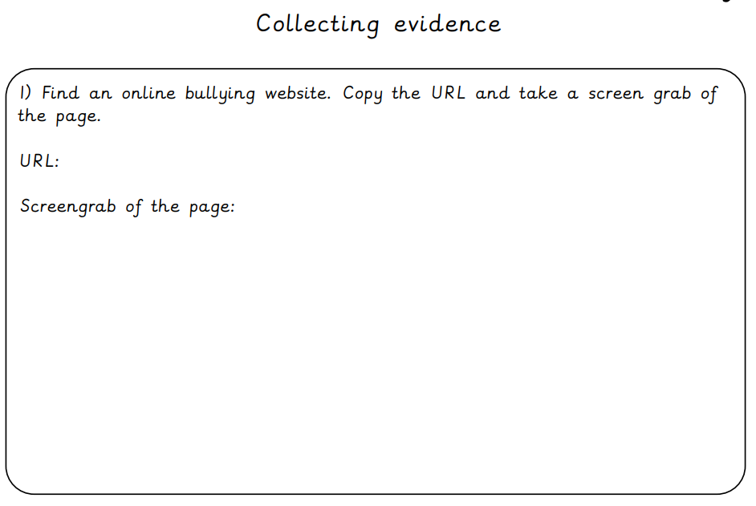

Slide 2
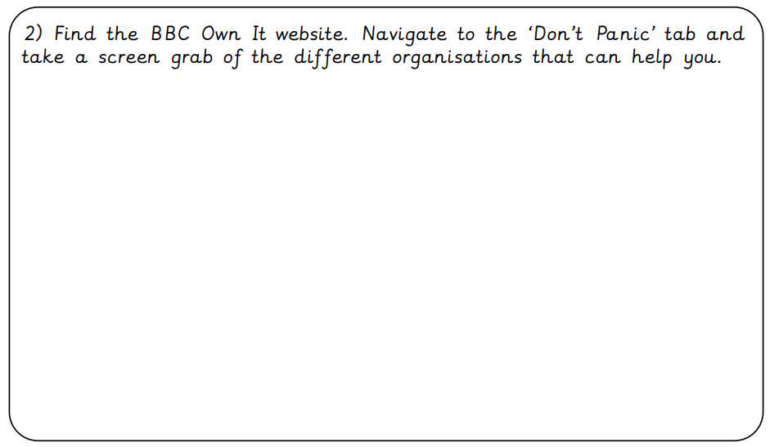

Slide 3
Extension: Create your own poster to show children some top tips for dealing with cyberbullying.

