Slide 1
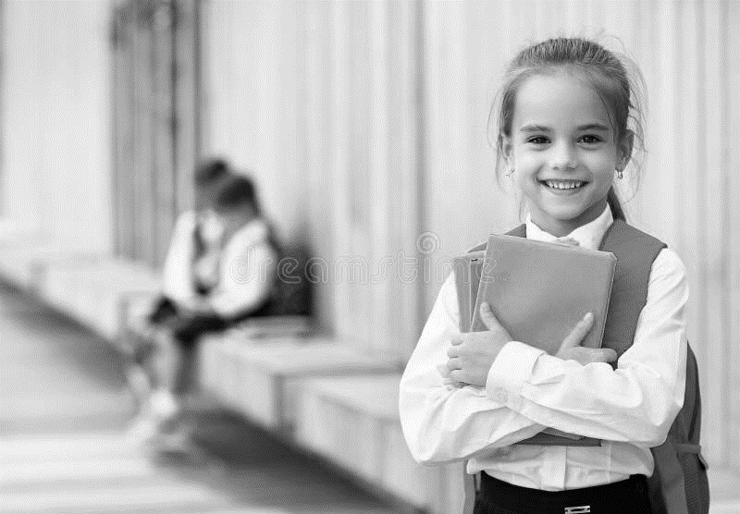


BRITISH VALUES
British Values in a
primary setting

Slide 2


Slide 3
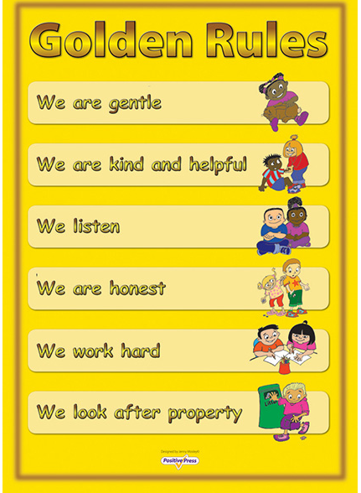
Rule of LAW
We teach the golden rules.
These are taught in assemblies and reinforced in class through rewards systems.
We link these to the rules of the country.

Slide 4

TOLERANCE OF DIFFERENT FAITHS AND BELIEFS
We currently have an Equity Council.
The Council meet monthly to discuss school wide issues.
It is made up of ‘invited students’ that represent a range of diverse communities including the neurodiverse, BAME, LAC, Young Carers, Military families, Children of same sex couples, Children with a barrier to learning and so on.
This group ensures that pupil voice is well balanced and representative of the school population.
Through KAPOW, pupils study a range of religious beliefs.
In our learning zone (a central part of the school,) regularly changed displays reflect the celebrations or events of our school, local and national community e.g. Diwali, Eid, Easter, Remembrance Day. The Diversity board shows how many cultures and languages exist in our school family.

Slide 5

INDIVIDUAL lIBERTY
At Stoke Damerel, we openly celebrate the uniqueness of each pupil. While we have a uniform policy and most children adhere to it, we allow flexibility e.g. Grey tracksuit bottoms rather than trousers if these are not appropriate for the child.
We are currently developing sensory safe classrooms; this means that all pupils can use fidget toys, sensory items such as headphones or take movement breaks, if needed. Adults are encouraged to model using these things.
Children can take part in wider roles or responsibilities irrespective of their age e.g. Reading Buddies, Playground Friends, Cleaning the hall after lunch.
Children are taught their rights- UN Convention of the Rights of the child.
Our Behaviour policy is restorative and always enables each child’s voice to be heard and understood.

Slide 6

DEMOCRACY
Children vote for their School Council rep and their Eco-Council rep.
Children vote to make decisions as appropriate
We talk about the right to have a say and that in the world of decision making, a ‘majority’ is how choices are made. We teach the children that using a vote is an important thing and shares their voice in the hope of change.

Slide 7
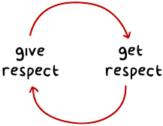
MUTUAL RESPECT
Behaviour sanctions are delivered respectfully, with an explanation and a basis in natural consequences wherever possible.
Children and adults are treated with equity. Adaptions and support are given to all, as requested or needed.

