Slide 1

WELCOME TO STOKE DAMEREL
PRIMARY ACADEMY
Year 3
September 2024

Slide 2
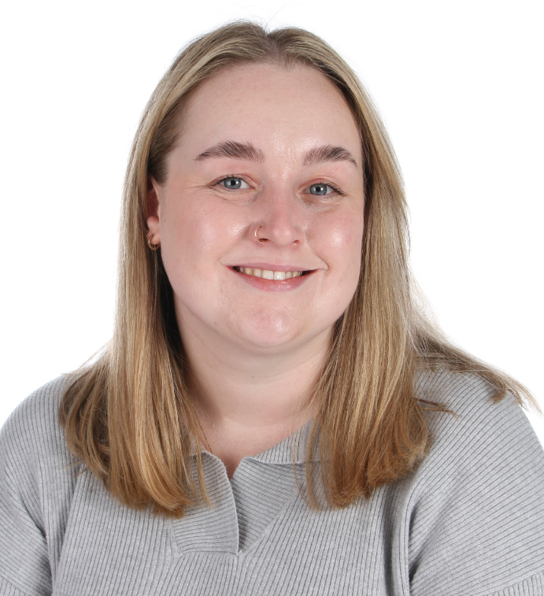
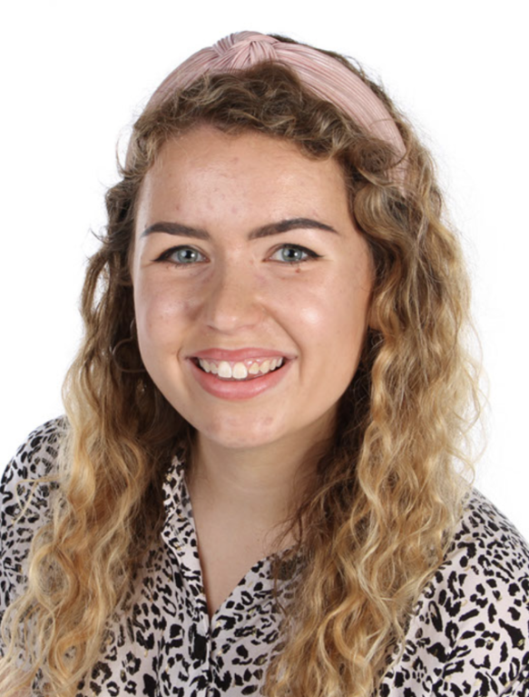
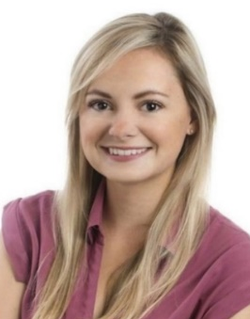
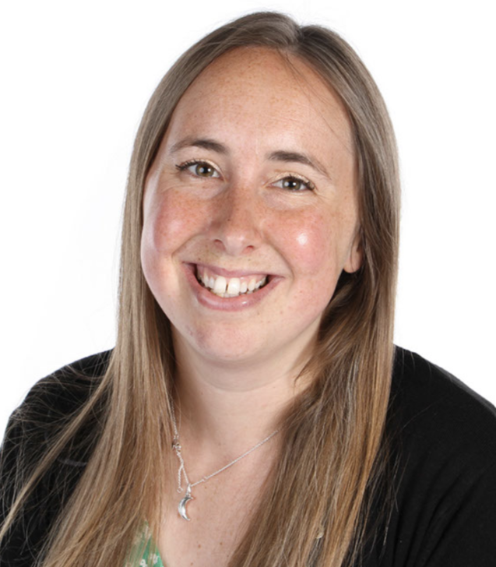
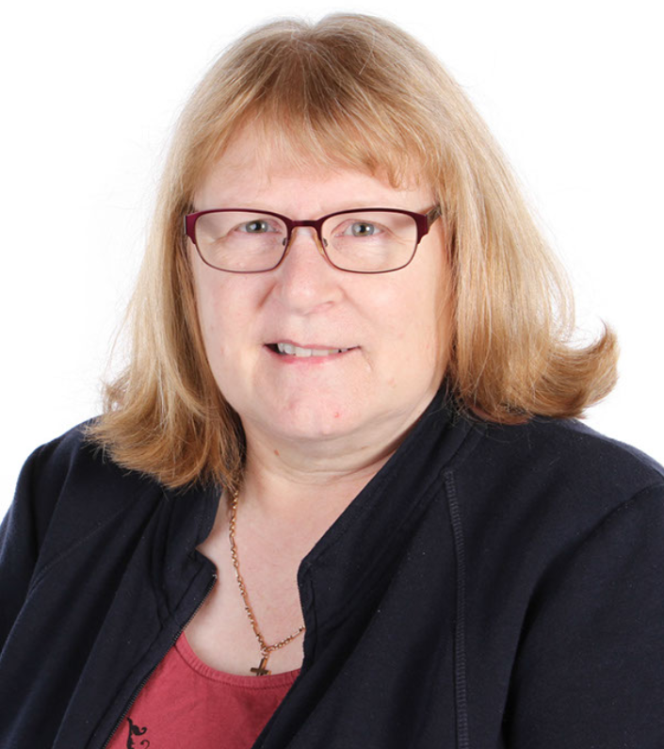
STAFFING
The Year 3 classes are:
Neverland
Wonderland
Sherwood Forest
Gill Whittington & Sarah Martin
Alice Wademan
TA: Tina Roden
Maisie Shepherd

Slide 3
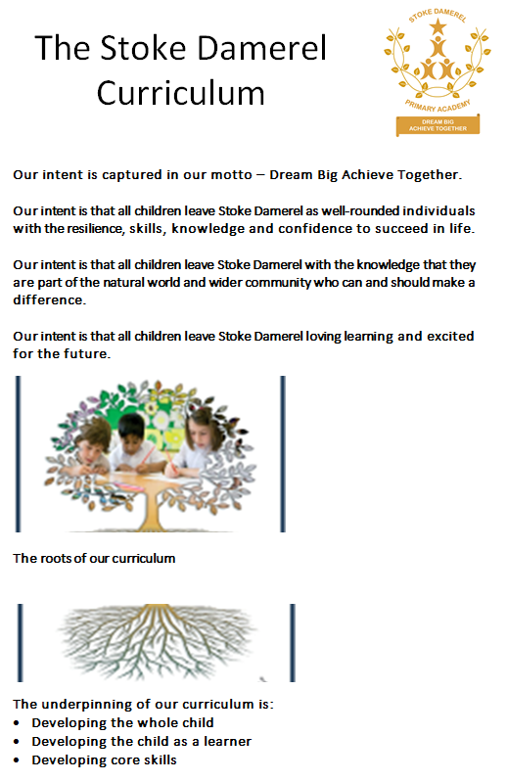

DEVELOPING SKILLS AND ATTITUDES
I can have a go
I enjoy challenge
I am curious about the world around me
I’ve got my own ideas that I’d like to try
I can keep trying until I can do it
I can understand how others feel

Slide 4

How we support learning in Reading
Daily reading and phonics through Read Write Inc.
Independence and choice of books
Sharing whole class books
Setting an example as staff who love reading!
How you can support learning in Reading
Listen to your child read and talk about the books they are reading
Encourage them to read a little EVERY DAY!!!
Please record in the reading record – your child will want to collect stars for their bookmark and send it to school daily
We will change reading books every Friday
Your child may also bring home a Book Bag Book which links directly to what they have learnt in their Read, Write Inc. group. Please ensure that this is kept in their book bag as it will be changed every few days. Once they are a more confident readers they won’t have a book bag book but will have class reading books.

Slide 5
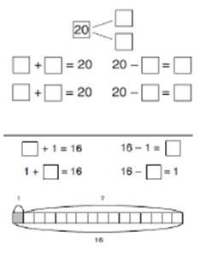
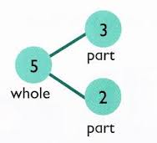
How we support learning in Mathematics
Daily maths and mental arithmetic lessons.
Focus on understanding by teaching with the
concrete (objects), pictorial (pictures), abstract (written) method
How you can support learning in Mathematics
Support through Times Tables Rockstars practise. Your child has log on details sent home with them in their Reading Records.
Look at maths opportunities in the real world – money, time, measures …
Notes:
Link to Website – Curriculum – Maths calculation strategy guidance.

Slide 6

How we support learning in Writing
Engaging with talk, drama and creative tasks
High quality books
Modelling good writing practices
Giving the children purpose for their writing
Supporting grammar, spelling and punctuation learning
How you can support learning in Writing
Support spelling homework – These will be given to your child on a Friday and tested the following Friday.
Encourage pencil grip, good seating and writing at home e.g. thank you letters after a birthday

Slide 7
How we support learning in across the curriculum
We use KAPOW
Subjects are taught discreetly- Science, History, Art..
Lessons are delivered through a range of mediums including practical tasks, singing, role play, construction, debate, research and experimentation.
How you can support wider learning
Ask your child about their learning when you collect them.
Encourage wider enrichment such as a visit to a key place of interest e.g. the Box, the Hoe,
Follow their lead- your child might enjoy crafting at home, reading widely about areas of interest, making things, drawing things, being active outside
Encourage them to try to explore new things, new tastes and new hobbies/experiences

Slide 8
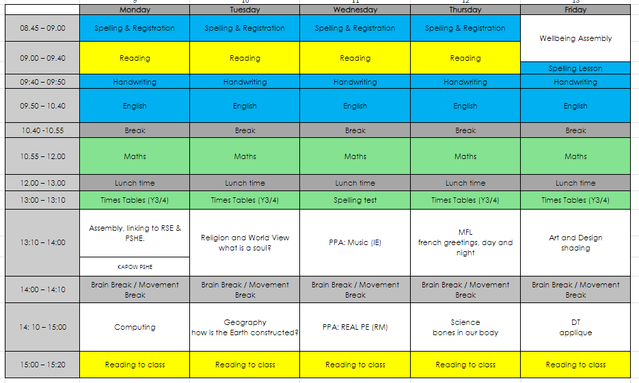
Day to day

Slide 9
The Year Ahead
Previously in year 3 we have arranged local trips, related to our learning.
We support the LKS2 panto, in the role of choir.

Slide 10

Assessments
We will contact you throughout the year to share your children’s results and advice on how to help your child at home.
We regularly update their CEW knowledge.
Children are assessed every term in Writing, Reading and Maths
Phonics is assessed every 6 weeks.

Slide 11


How to help at home
School readiness – good night’s sleep, healthy breakfast, calm journey to school, arrive at school on time
Healthy snacks & water (no juice or squash please!). Water bottles are the children’s responsibility, as with other equipment they can get broken – please name.
Homework:
Times Table Rock Stars
Spelling
- Daily reading

Slide 12


Rewards
Reading stars
Class dojos
Golden tickets
Star of the Week
Superstar Cup

Slide 13
How to contact your child’s teacher
If you need to get a message to the class teacher during the school day – EG: changing the person collecting your child from school - please contact the school office.
(Please avoid ringing between 8:30 and 9:30 am, as this is their busiest time.)
If you need to ask a question or inform your child’s teacher about something, please email your child’s teacher directly.
Teachers will pick up their emails after school and respond to you accordingly.

Slide 14

Thank you for coming ☺
Any questions?

